Slide 1
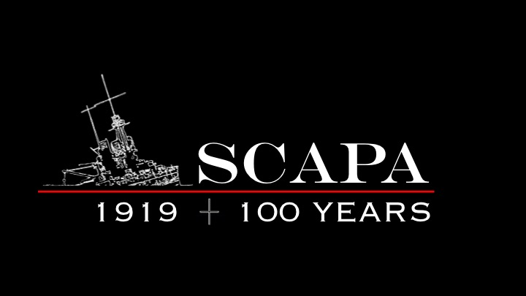
THE GERMAN FLEET SCUTTLE, 1919
ITS CONTEXT AND IMPACT

Slide 2
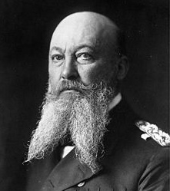
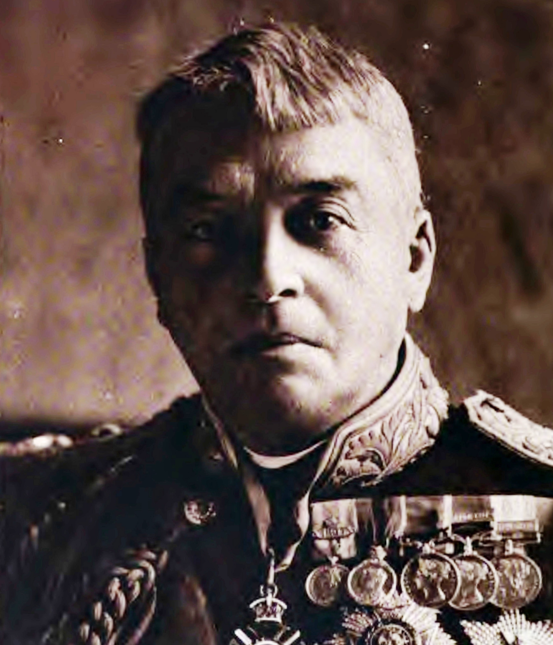
THE THREAT TO BRITISH
MARITIME SEAPOWER
Germany traditionally a land-based power
Appointment of Alfred Tirpitz to lead his fleet building programme, Bernard von Bülow to manage the diplomatic front
Growing recognition of maritime threat:
  1902 Anglo-Japanese Alliance
  Reduced Mediterranean naval threat & Entente Cordiale
The Naval Arms Race
  HMS Dreadnought
  1909 Naval Estimates
Alfred von Tirpitz
Sir John Fisher
Notes:
While Germany traditionally land-based power, Kaiser Wilhelm was always jealous of Victoria’s navy and the freedom of manoeuvre it gave her
Decided to build a fleet to challenge Britain’s dominance
As North Sea threat increased, Britain concentrated its resources:
Far East
Mediterranean
By mid decade we were in a flat out race
Dreadnought changed the game but was too early

Slide 3
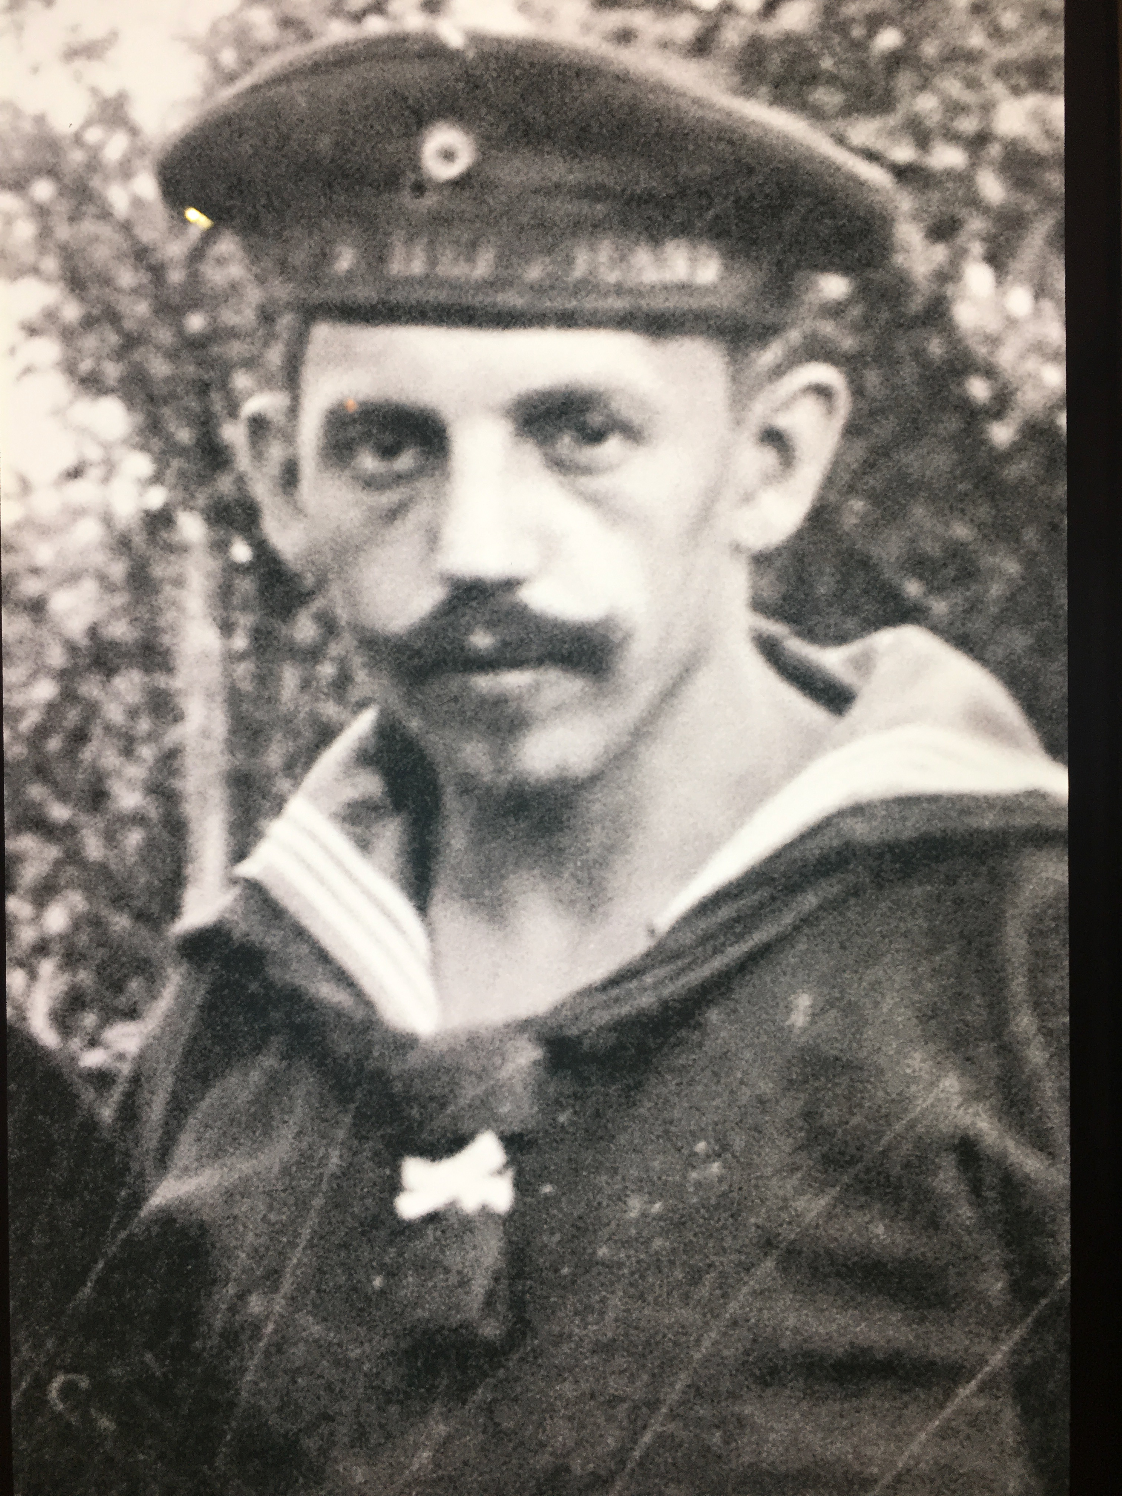
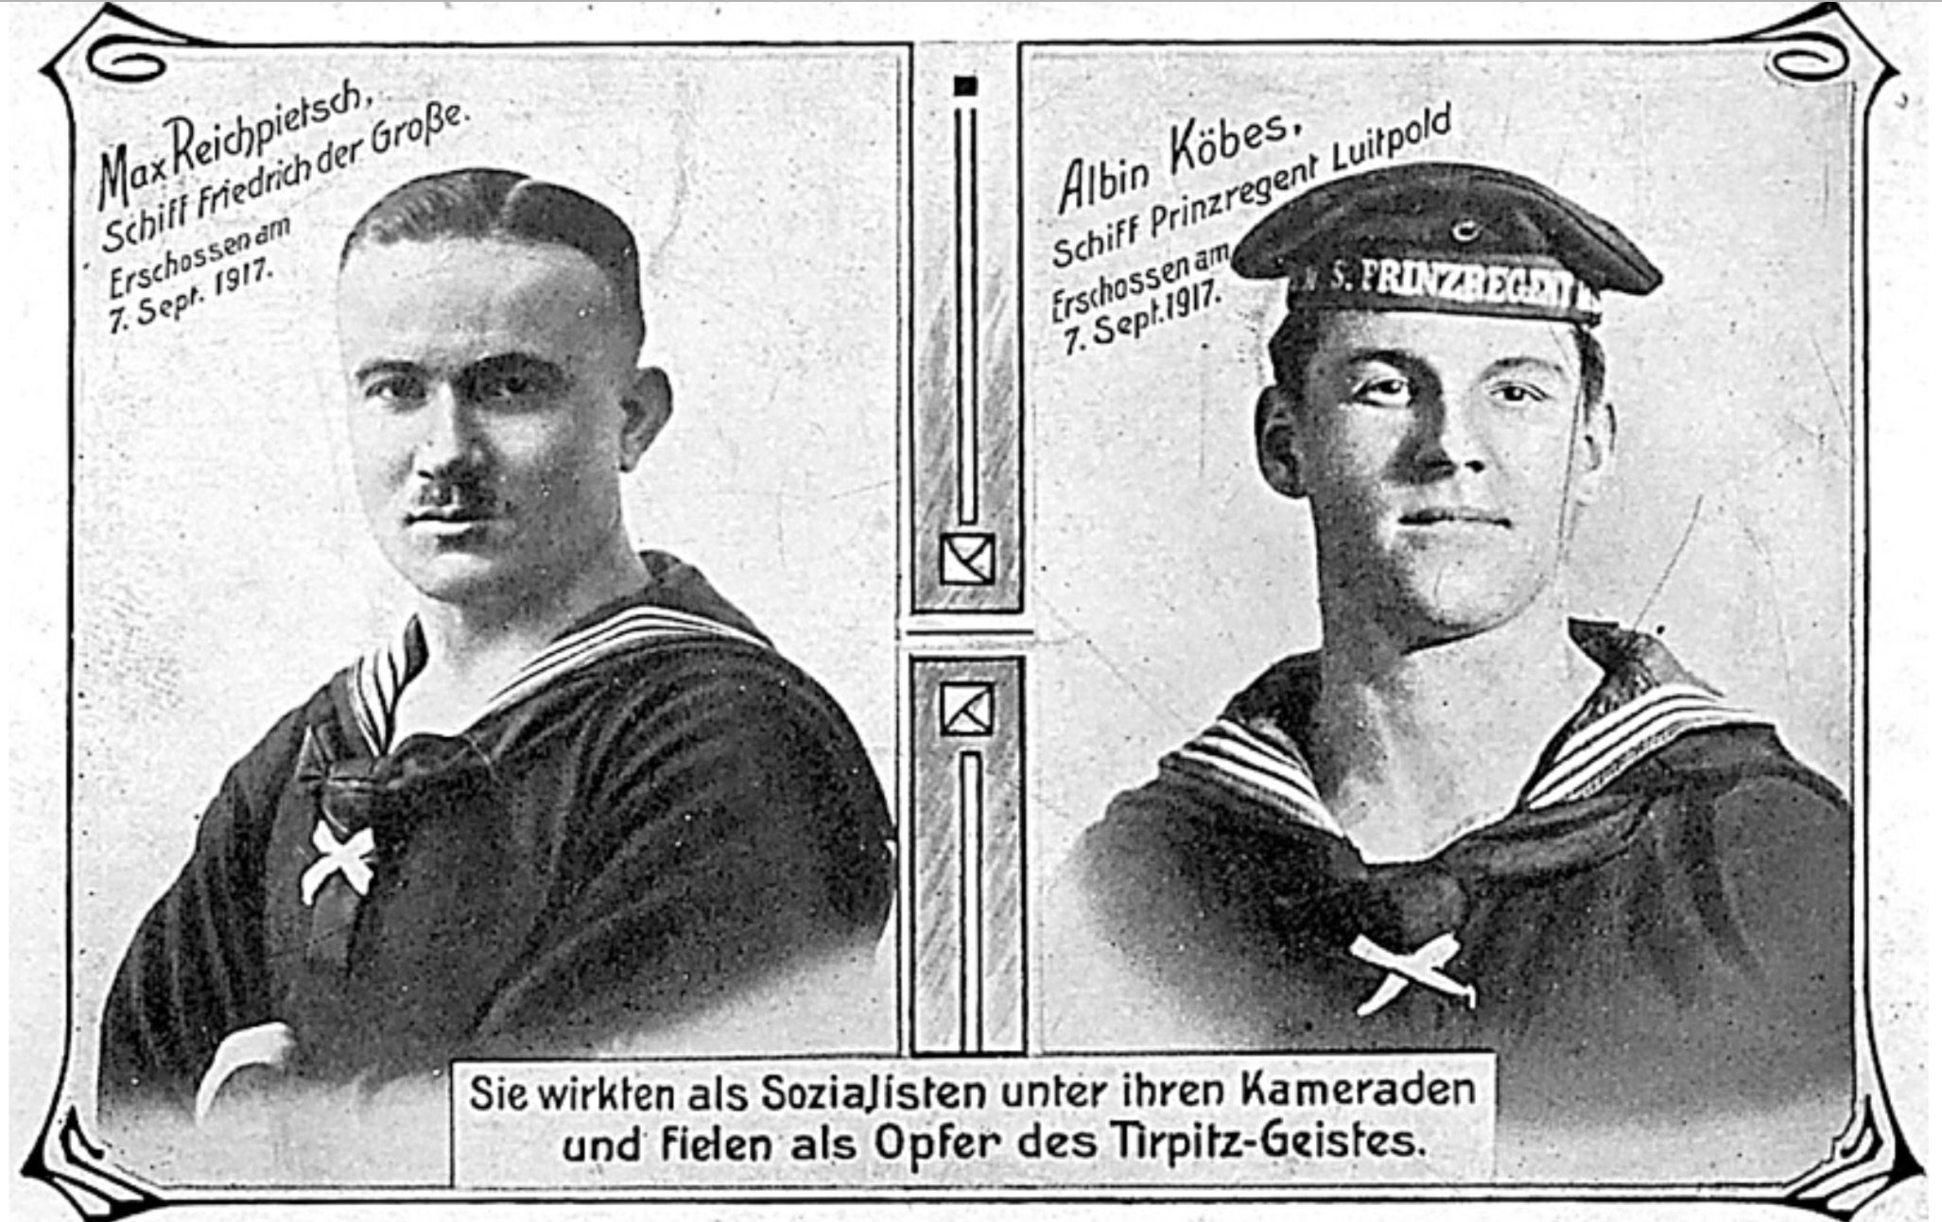
GERMAN NAVAL UNREST
  Germany’s social divisions reflected in Navy
  Food and working conditions
  Rations Committees (Menagekommittee)
  July film visit cancelled, 1 August 47 stokers walk off Prinzregent Luitpold, 11 arrested.
  Sept. execution of Albin Köbis (Prinzregent Luitpold) & Max Reichpietsch (Friedrich der Große)
Richard Linke
Reichpietsch and Köbis
Notes:
-. Stephan has talked about the war at sea
Being confined to port was not the only cause for sinking morale.
Conditions were not good: social and physical

Slide 4
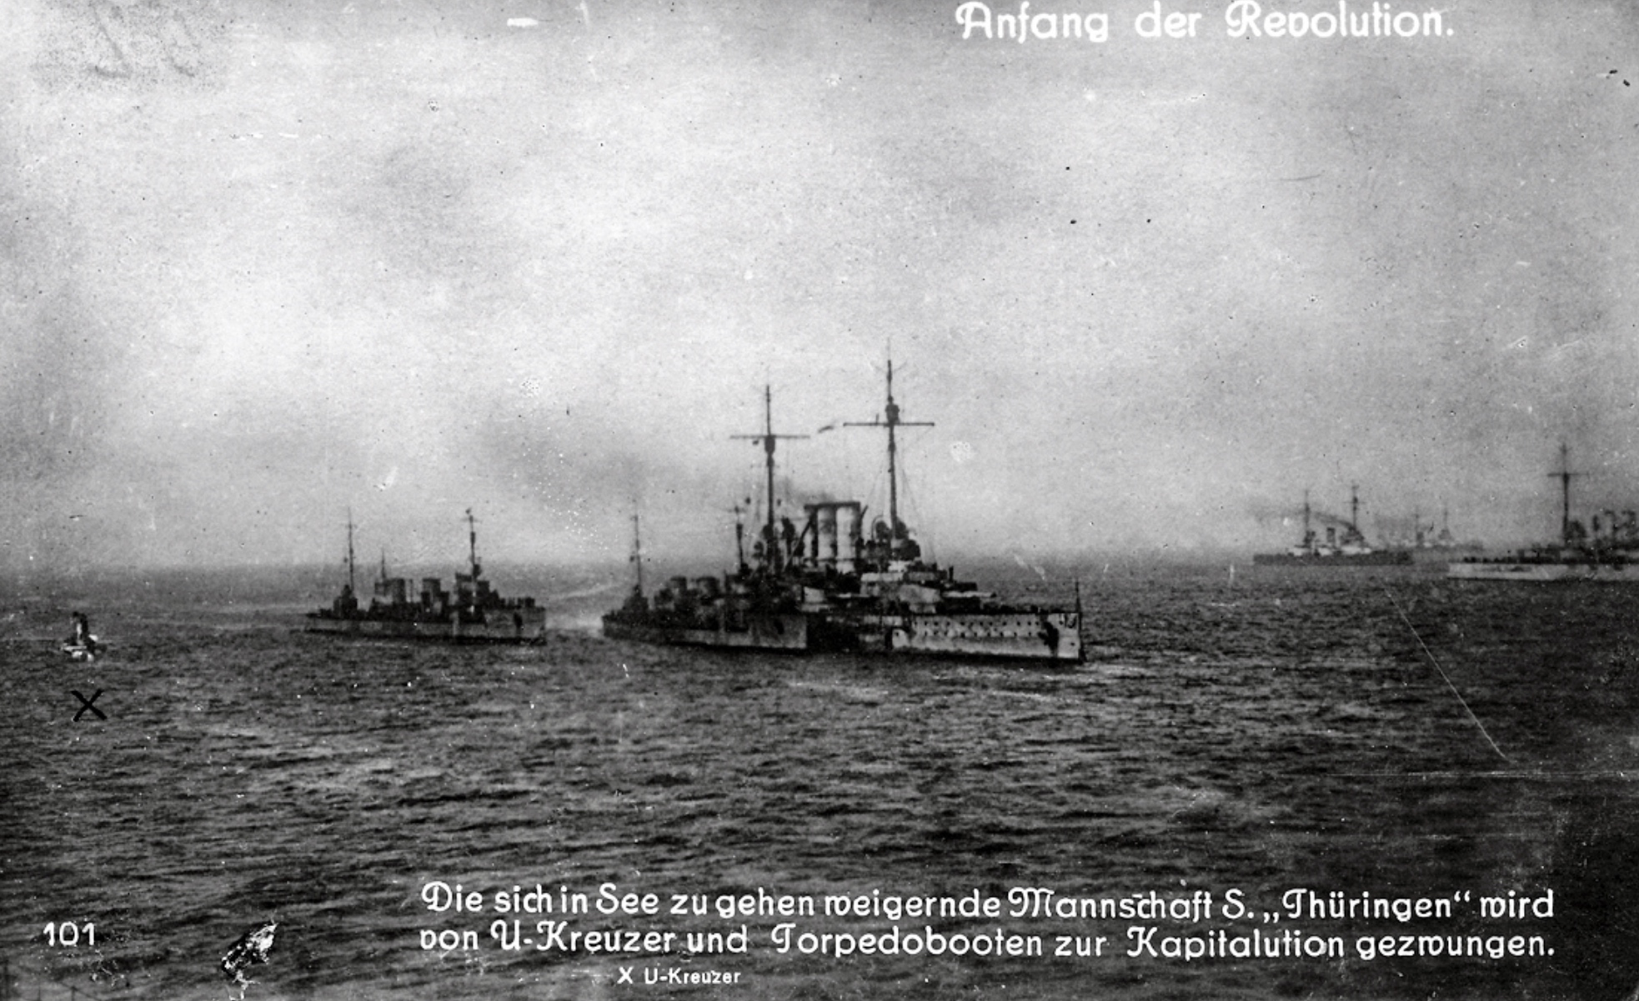
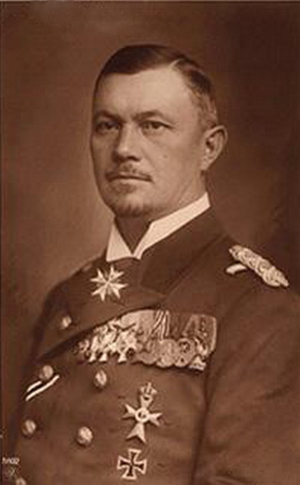
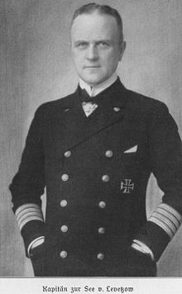
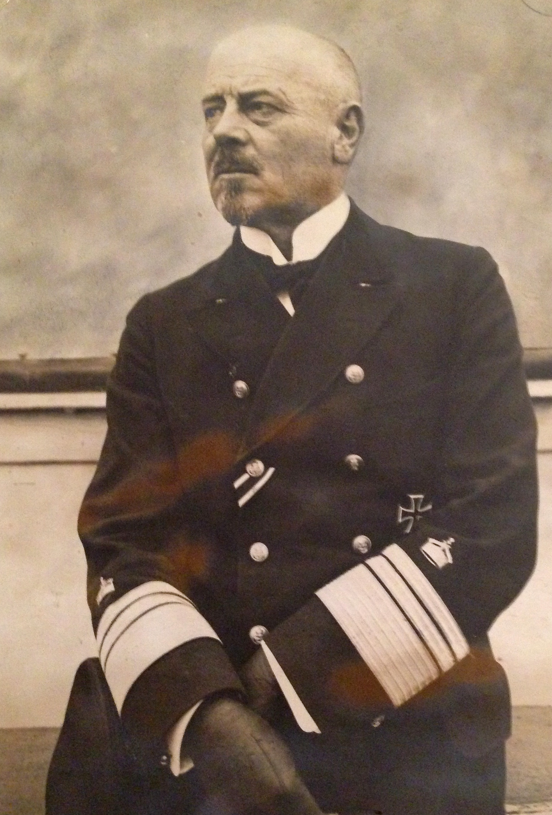
THE SPARK
OCT
2321
31
  Recall of submarine elements following US pressure
  Plan 19 plan for last sortie
  UB.116 sunk in Scapa as part of 30 sub deployment.
  Refusal of orders from crews on Thüringen and Helgoland.
  U.135 and 5 torpedo boats (IV Halbflotille) sent. B.97 about to fire when mutineers stand down.
SMS Thüringen and U.116
Scheer, Levetzow and Hipper
Notes:
The final straw. The SPARK, was the navy’s plan for a last battle with the Royal Navy.
Scheer was scathing about the incident. In his mind this was the moment when control was lost

Slide 5
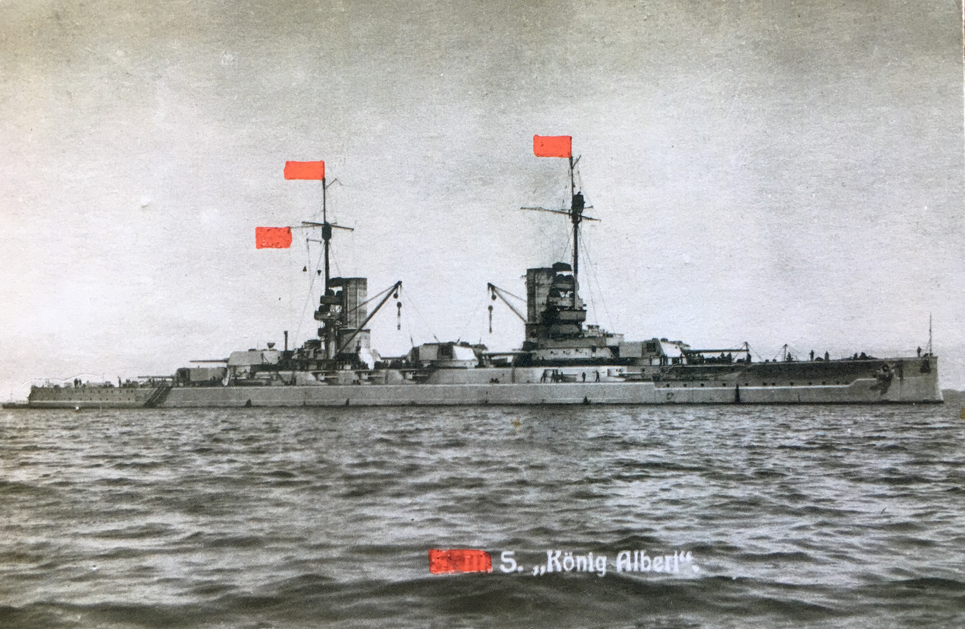
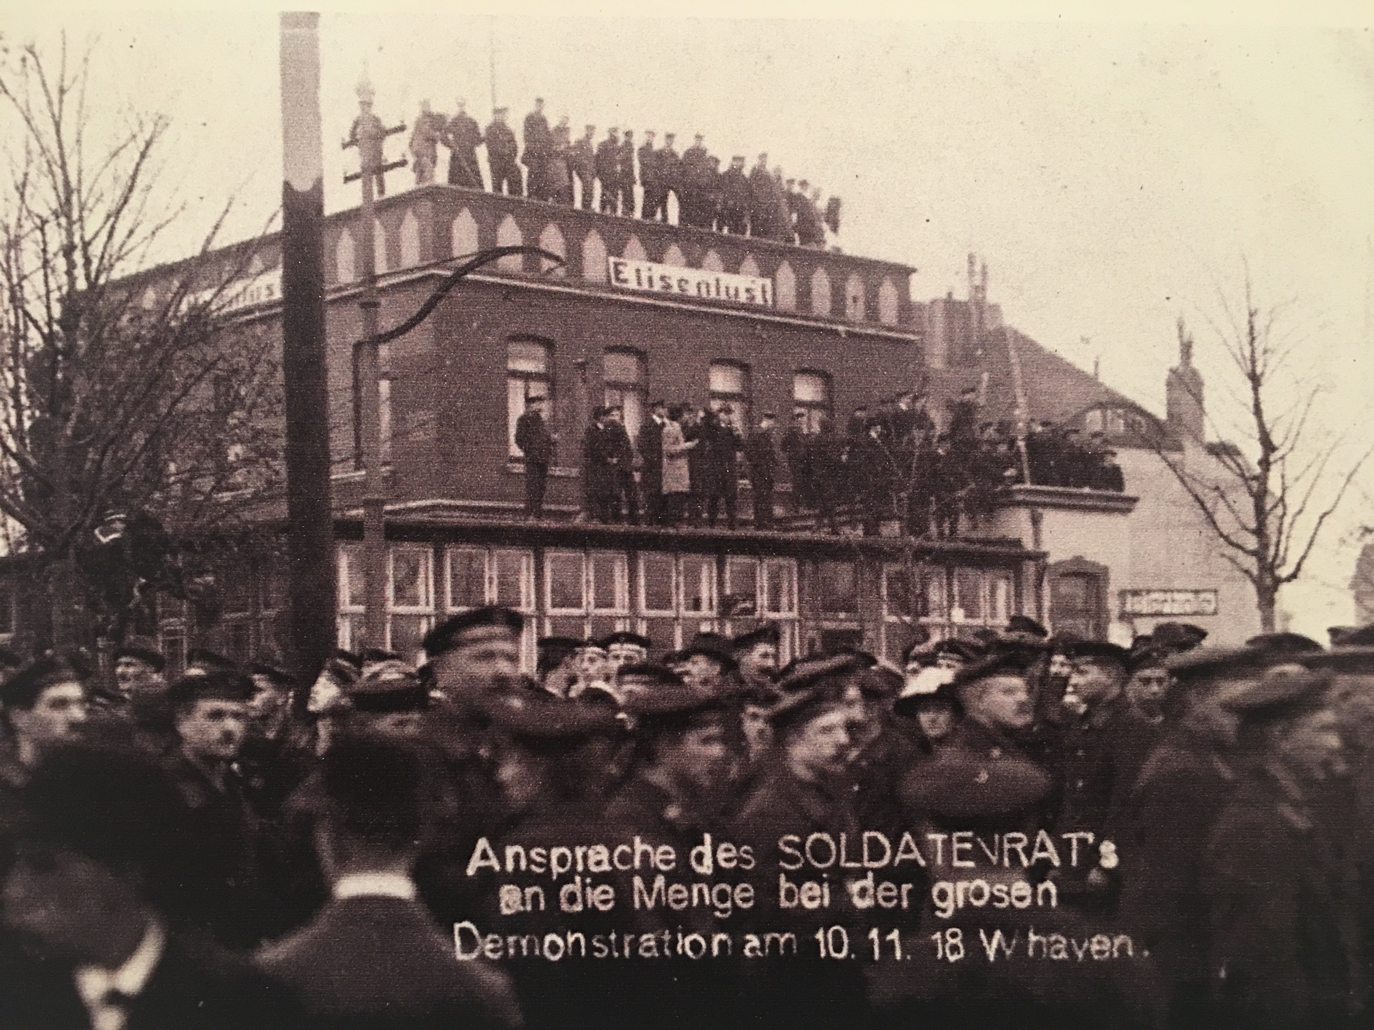
WILHELMSHAVEN
UNREST TO MUTINY
NOV
NOV
1
2321
2321
2
Postacr of SMS König Albert bedecked with red flags
  Surrender & return to shore
  Mass walk off from battleships, 20,000 strong demonstrations.
  Imperial flags lowered and red flags raised on all ships
  Council of 21 elected with a 5 man Executive Council.
Shore demonstration
Notes:
-The unrest comes ashore and one by one the ships come under revolutionary control.
Postcard shows red flags painted on to König Albert.

Slide 6
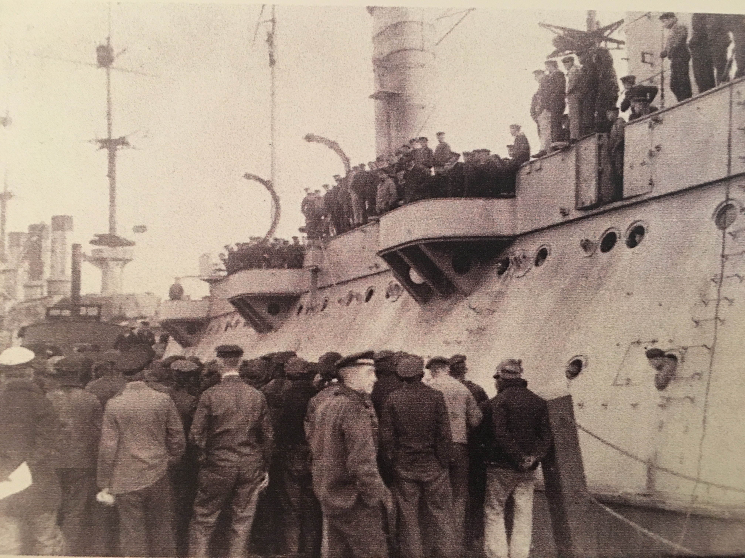
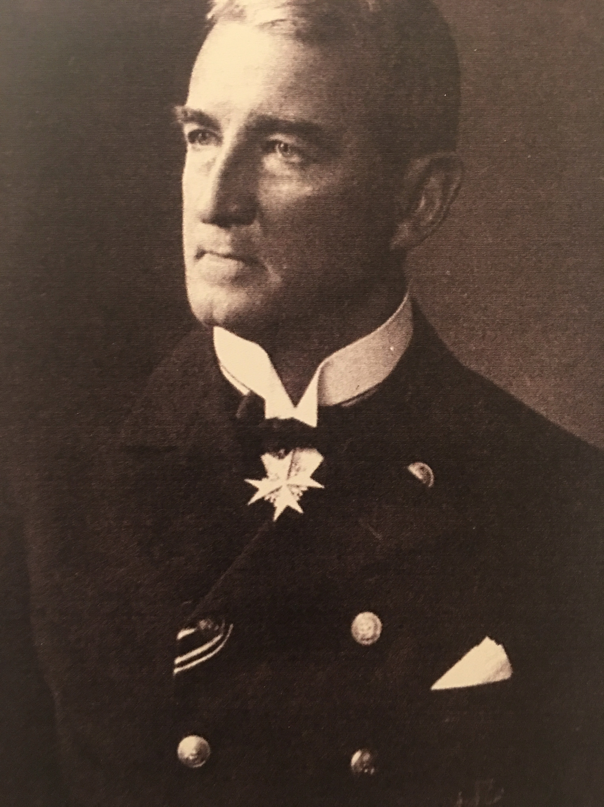
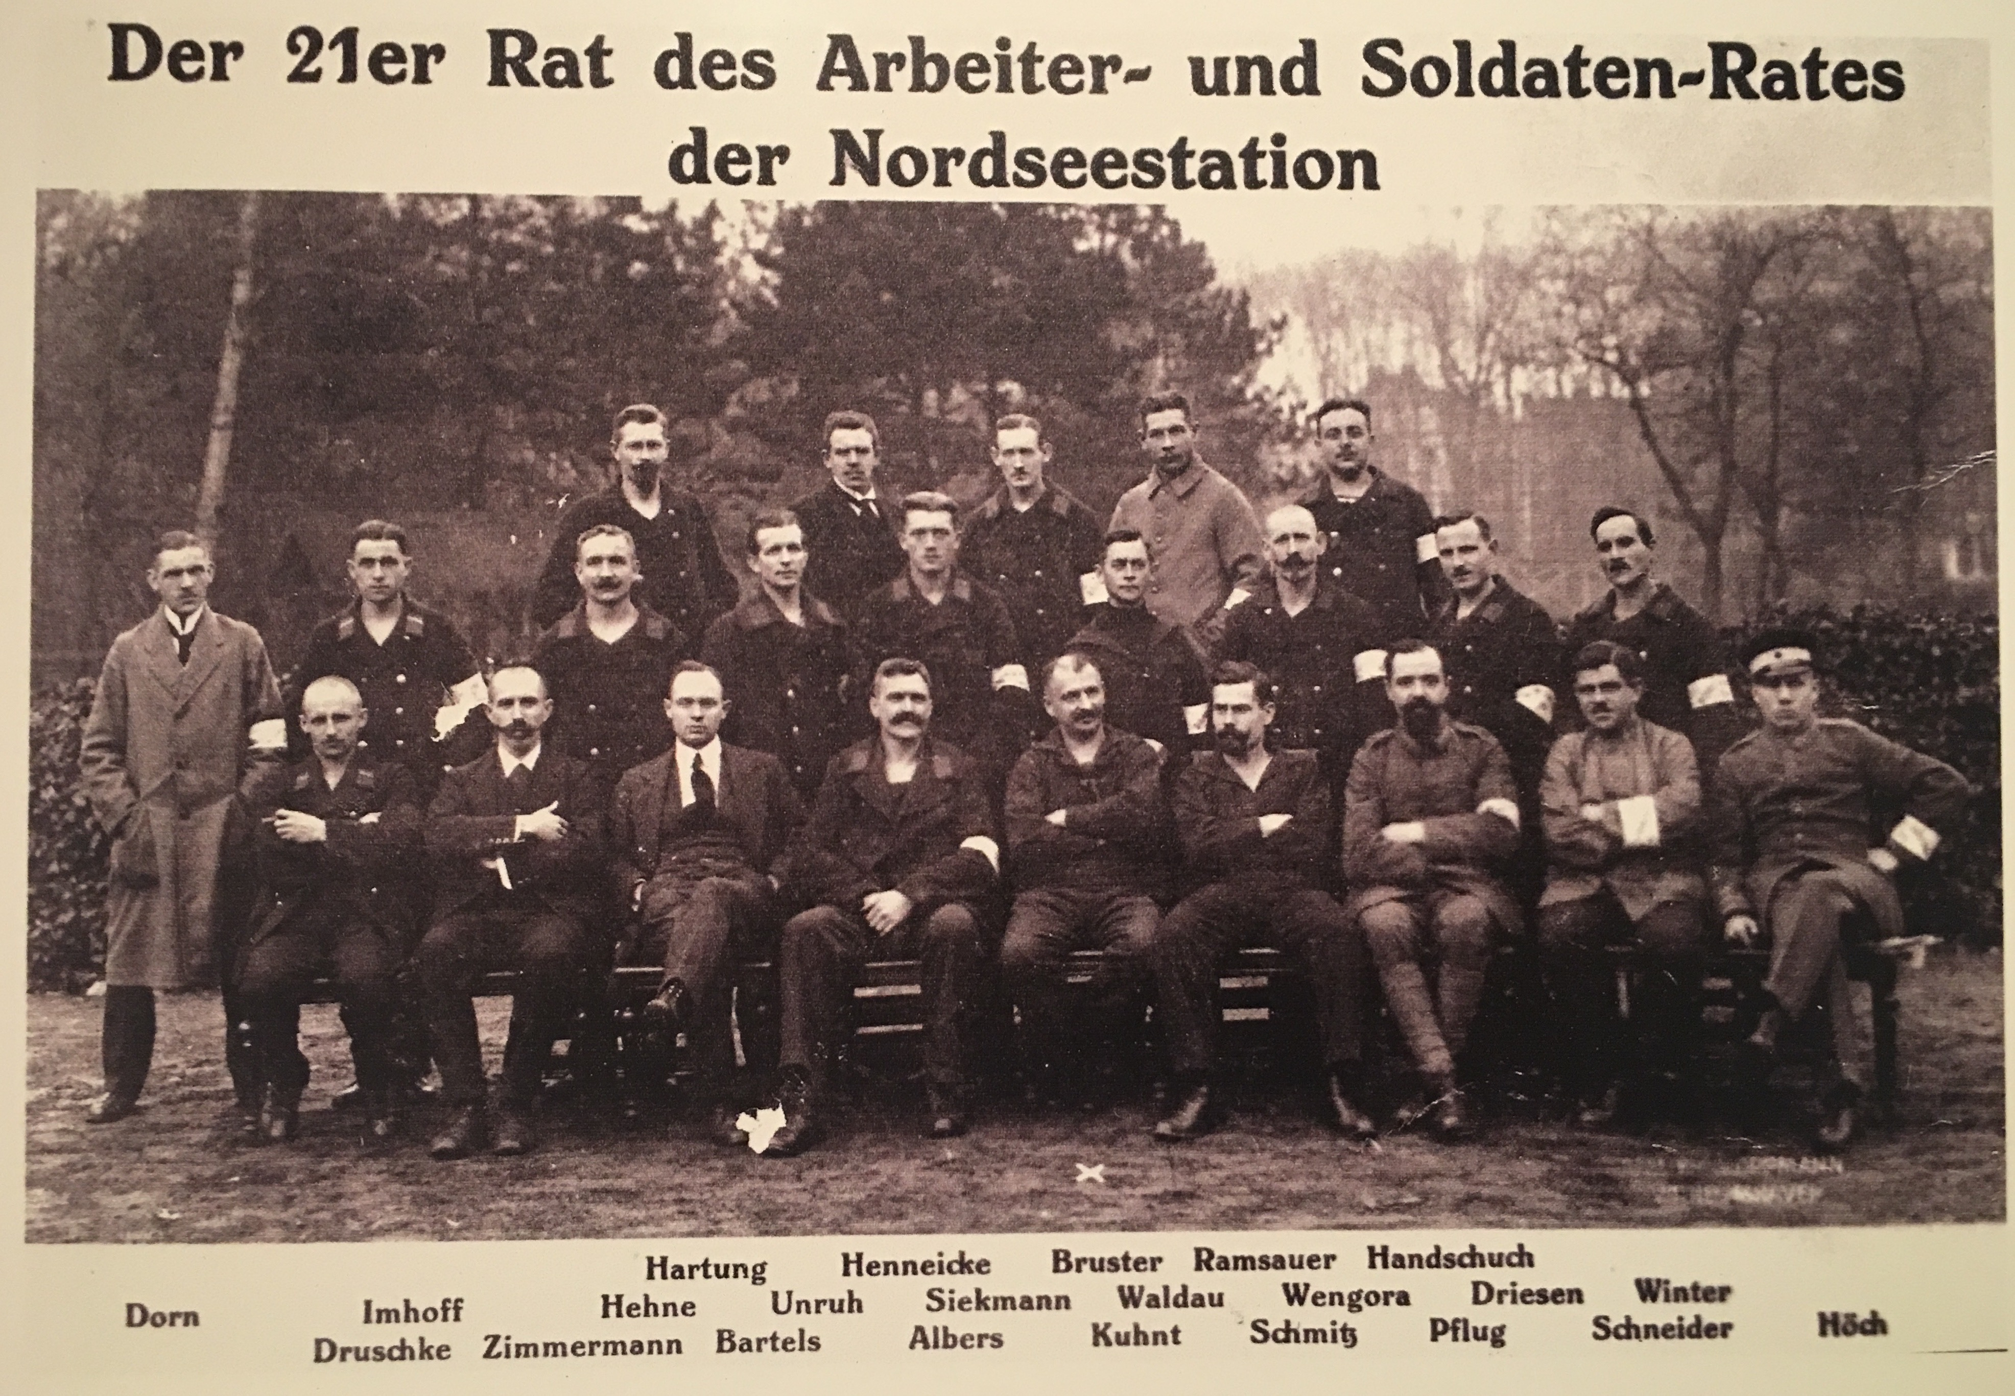
KIEL – FRIEDEN UND BROT
NOV
NOV
NOV
3
2321
2321
4
2321
5
One battle squadron sent to Kiel to isolate it. Opposite effect.
The mutiny evolves into revolution
Gusav Noske speaks to returning sailors
Wilhelm Souchin
Notes:
- But the real mistake was to separate one squadron – the 3rd - and send its ships (Markgraf, Prinzregent Luitpold, Große Kurfürst, Kronprinz Wilhem and Bayern) to Kiel.
- Kiel was an industrial city, the centre for the war armaments industry (Germanianwerft, Kaiserlichewerft, Friedrichort Torpedowerft). Its workforce was highly politicised. Already May 1917, the left social Democrat Party (the USPD) had 1,000 membership &B most shop stewards.
- New Garrison commander, Souchon, appeal for help was answered by the Government sending Gustav Noske to try to calm the situation in Kiel. It gave the impression of legitimacy.
- Kiel morphed the naval mutiny into revolution with the addition of unionised industrial political action.

Slide 7
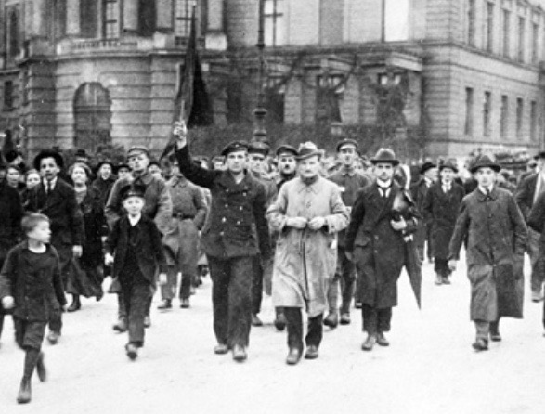
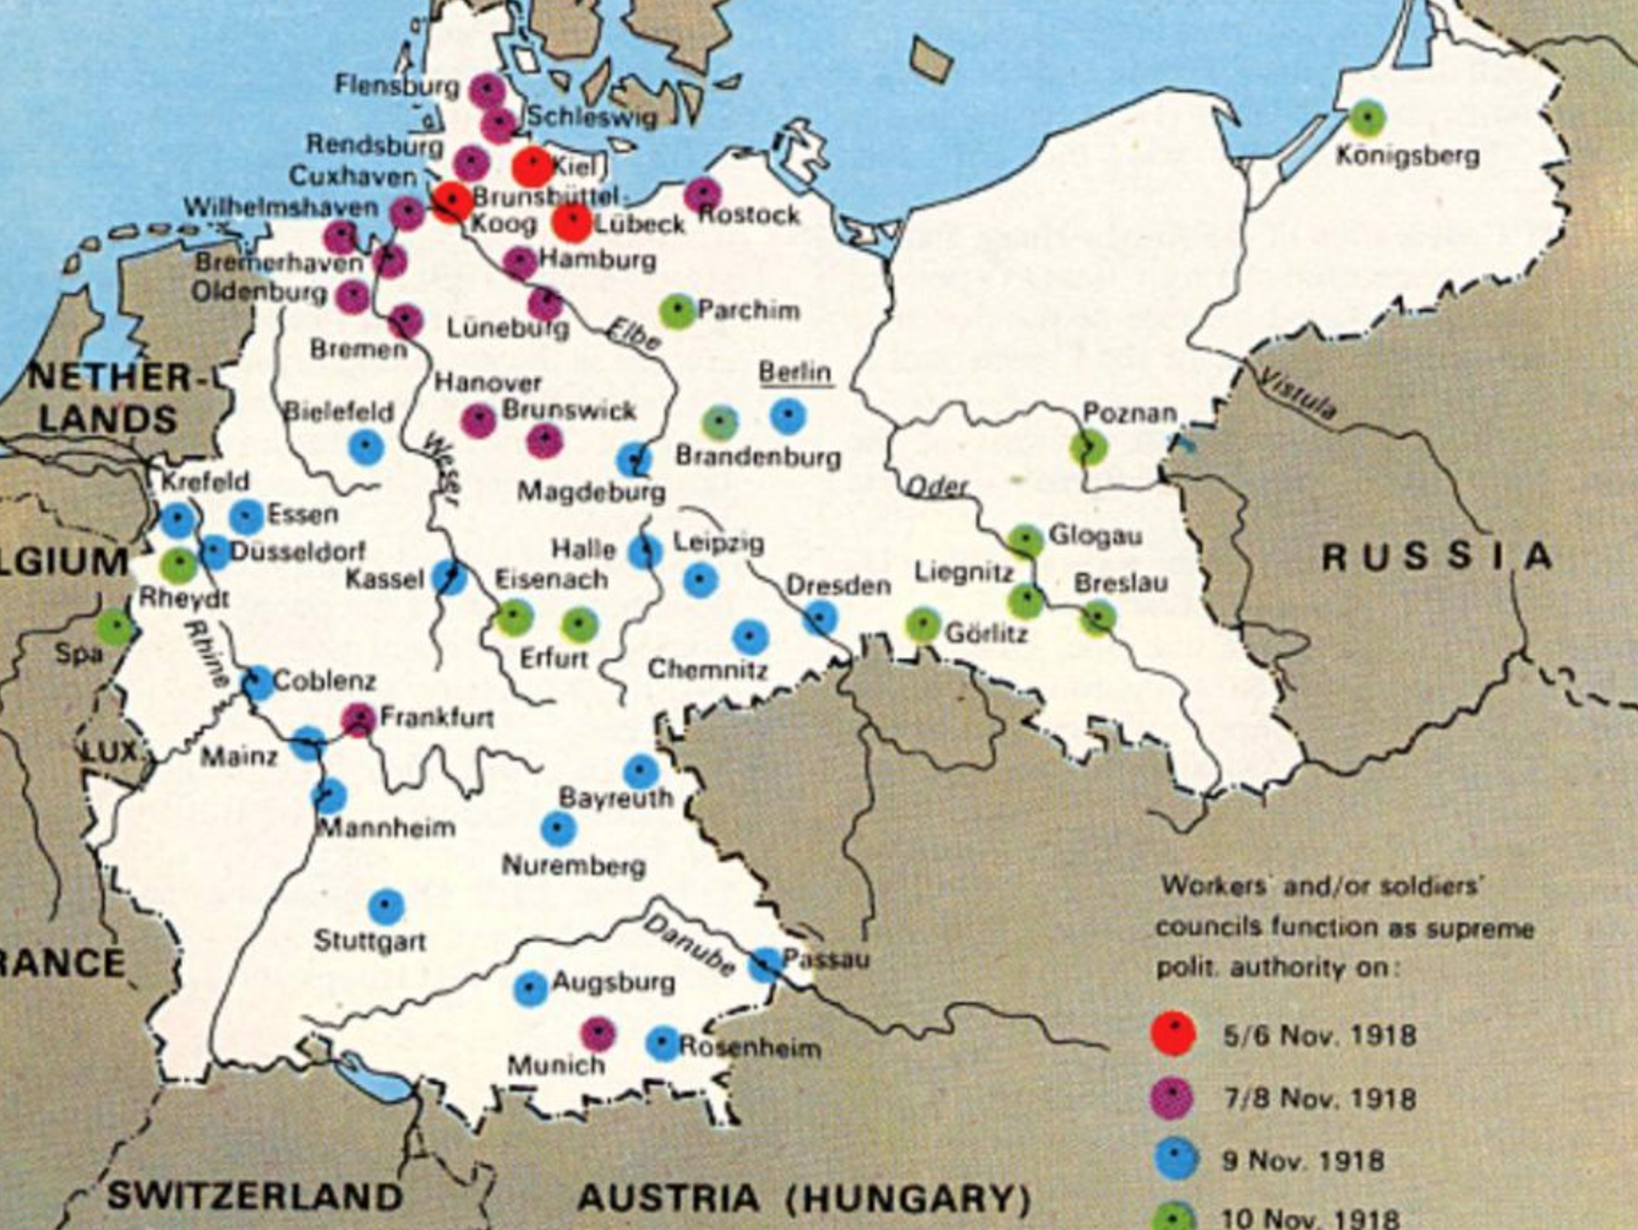
NOV
  Sailors and workers take the revolution through Germany
  Prince Max von Baden announces Kaiser’s abdication
  Republic declared in Berlin
6-9
2321
Notes:
From Kiel it spread to the other major seaports, Bremen, Hamburg, Lübeck

Slide 8
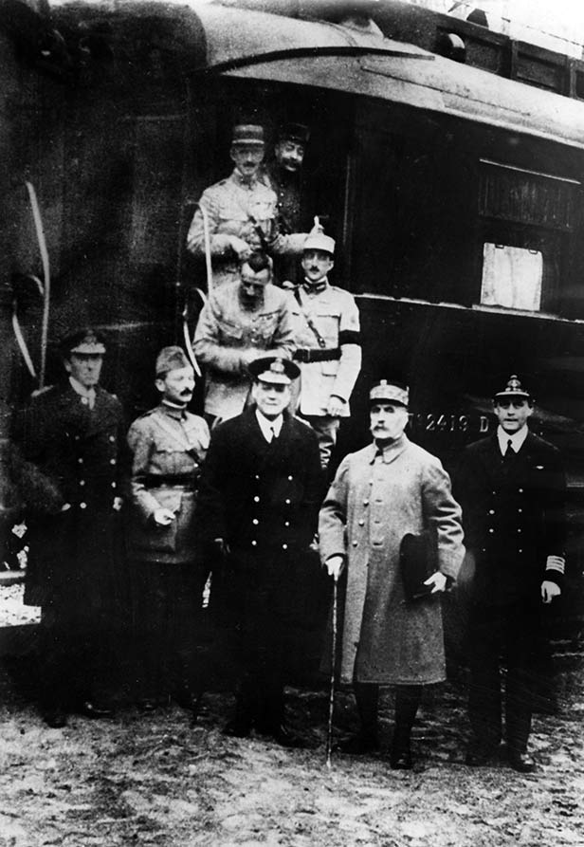
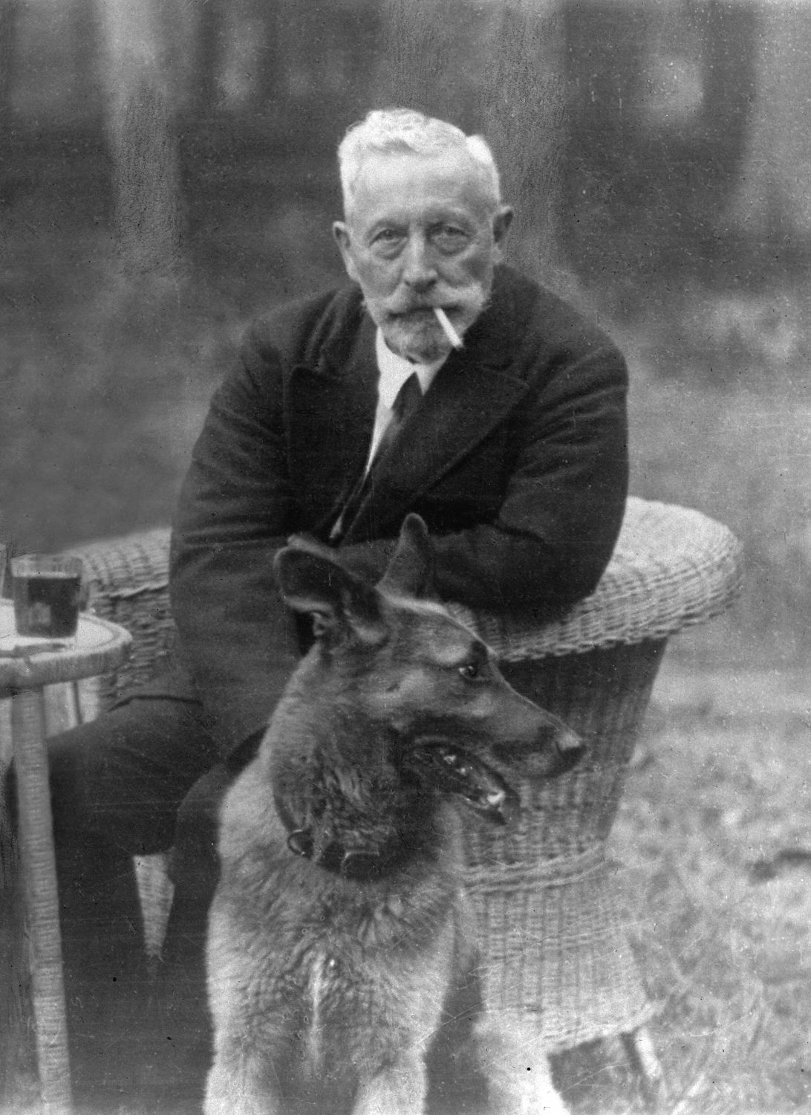
NOV
2321
11
  The Armistice is signed in Compiègne.
  The Kaiser heads to the Netherlands.
Compiègne – Hope, Weygand, Wemyss & Foch
The Kaiser in exile
Notes:
As the Armistice is signed in Compiege in one carriage, the Kaiser’s train takes him to the Netherlands. With 59 car loads of riches from the palaces.

Slide 9
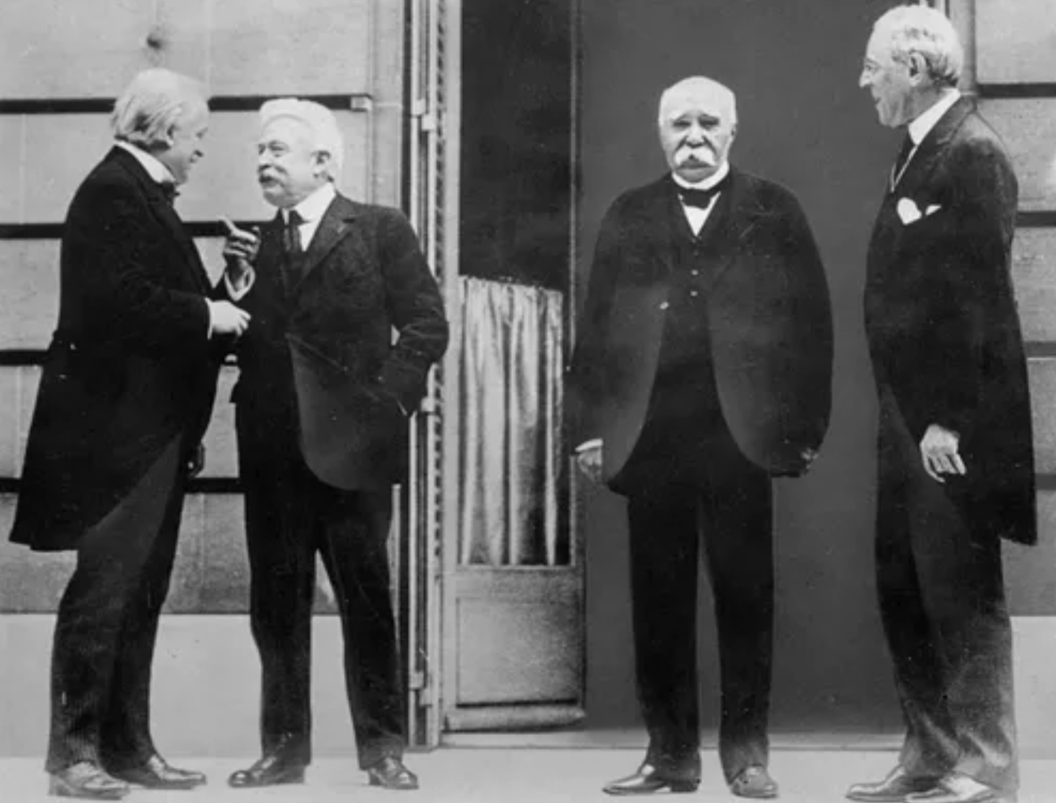
VERSAILLES 1919
18 Jan 1919 – 28 June 1919
run by the ‘Big Three’ (USA, Britain and France)
A temporary peace. Seeds of WW2
  Occupation of the Ruhr 1923
  Reparations postponement Treat of Lausanne 1932
  1936 German occupation of the Rhineland
Lloyd George, Orlando, Clemenceau, Woodrow Wilson
Notes:
The eventual terms negotiated at Versailles were very tough, decided upon by the BIG THREE Lloyd George, Clemenceau and Wilson.
France’s losses had been appalling.
As Germany had in 1870, France now wanted to destroy Germany’s ability to wage war.
Foch predicted it would be a 20 year truce but by 1923 things were heading in the wrong direction
Germany could not keep up with the payments and so the Ruhr was occupied

Slide 10
THE THORNY NAVAL QUESTIONS
GENERAL TERMS
  Freedom of the Seas an existential issue for the British
  Eventually,
    US drop Freedom of Seas position & international agreements focus
    British acceptance of Monroe doctrine and idea of League of Nations
THE FATE OF THE GERMAN NAVY
  1. France
    Symbolic destruction
    Redistribution with France receiving major boost in naval standing
  2. United States
    Early promotion of destruction politically irreconcilable with Wilson’s new Navy position
    Integration into USN difficult and would pull back a more technologically advanced navy
  3. Great Britain
    Beatty / Admiralty: Switched positions from destruction to integration based on the naval losses
    Strong preference for surrender turned down. Internment put forward
Notes:
What concerns us are the naval terms. The US was pushing hard to seek ways to reduce Britain’s seapower.
Became increasingly clear that Britain would not be pushed on Wilson’s 2 üoint in his famour Fourteen Points.
We would not give up our use of seapower
What to do with the German ships?

Slide 11
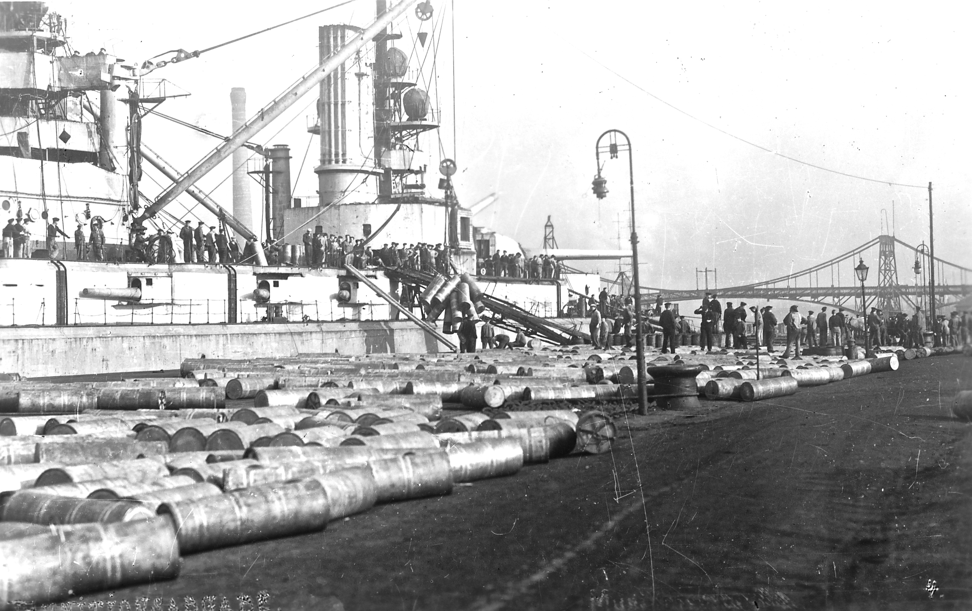
LEAVING WILHELMSHAVEN
All munitions off-loaded
Minimal Food and coal stocks
Minimally crewed
SMS - , de-ammunitioning, Wilhelmshaven
Notes:
Hugo von Meurer met with Beatty on 14 / 15 November. He was told what needed to be done. There was no negotiation

Slide 12
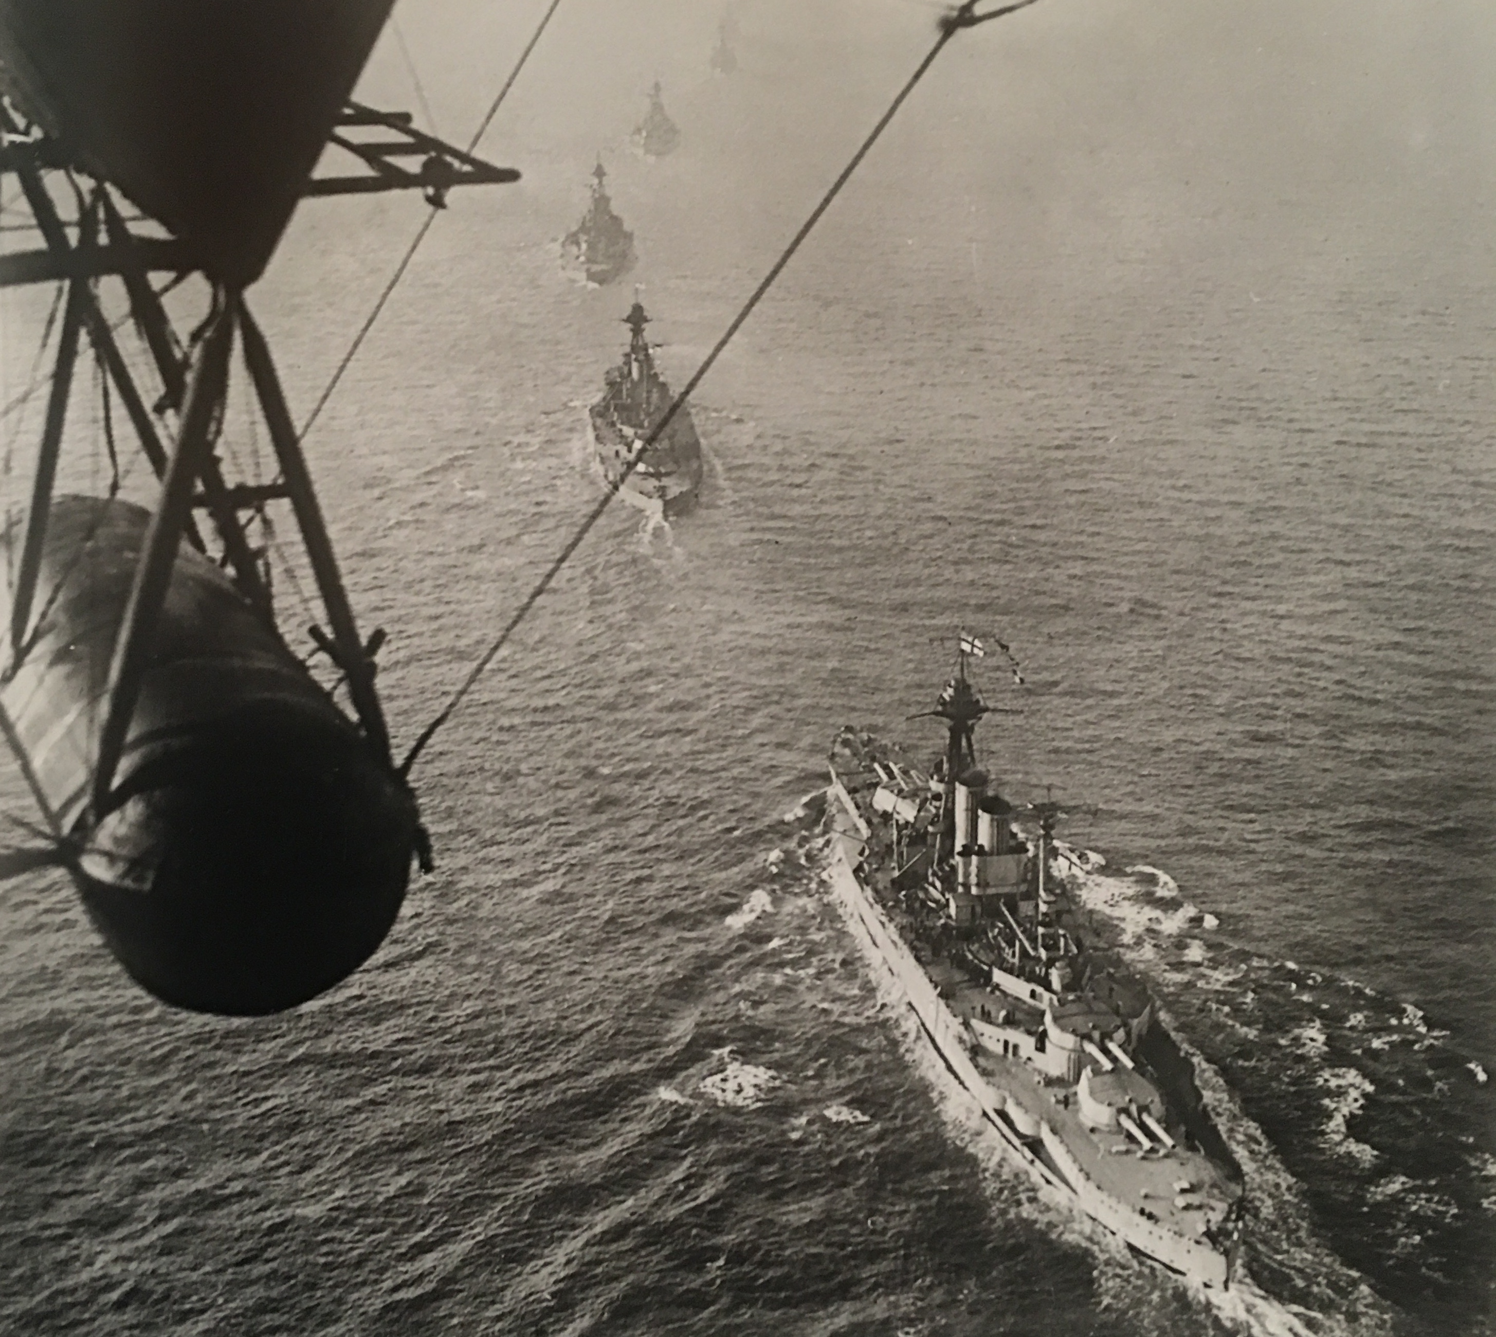
ROSYTH
NOV
21
2321
Met by 250-strong allied Fleet – including American 6th BS and French ships.
Escorted into internment (technically not a surrender) via Rosyth
HMS Queen Elizabeth

Slide 13
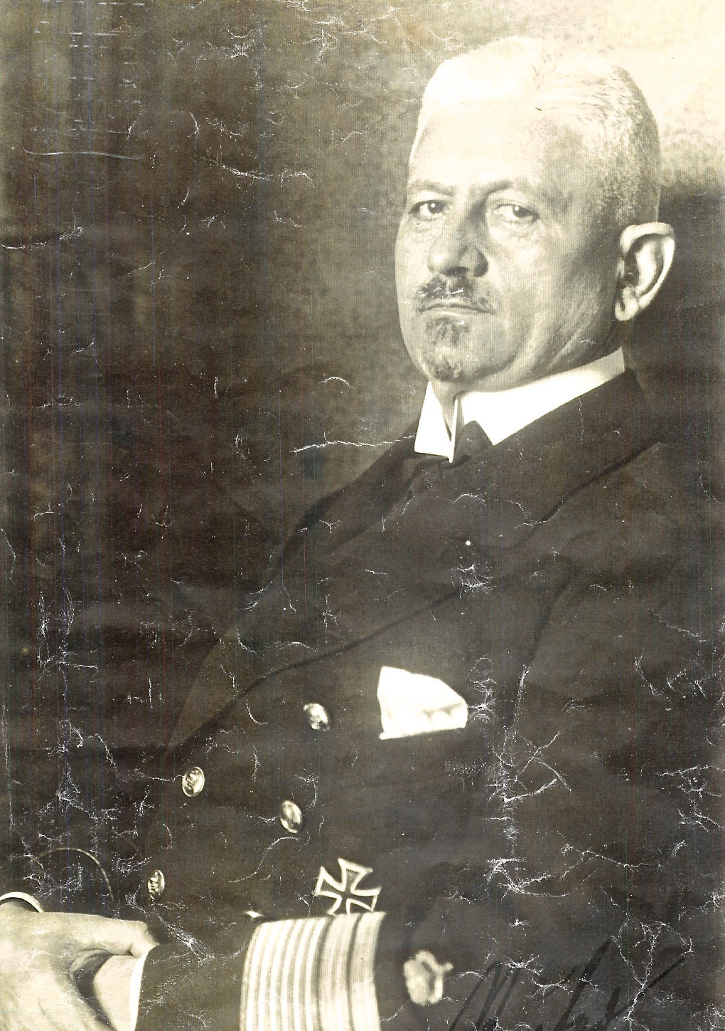
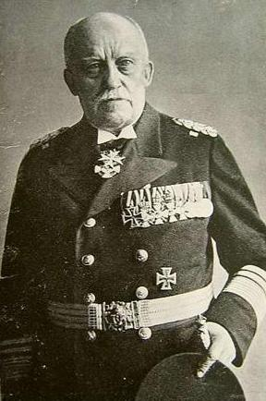
THE DECISION TO SCUTTLE
Reuter’s key assumptions:
  Either terms rejected – war would be resumed. Ships would be seized.
  Or terms would be signed – beneath the dignity of serving officers and ships surrendered to allies.
‘Standing orders’ Reuter anticipated British seizure at midday 21 June 1919 (the day he assumed the Peace terms were to be signed).
Ludwig von Reuter
Adolf von Trotha
Notes:
How did Reuter arrive at the decision?

Slide 14
THE NUMBERS
490
423
58
INTERNED FLEET TONNAGE
TONNAGE SUNK
490 VS.
TONNAGE
BEACHED
Notes:
CURRENT BRITISH NAVY
DESTROYERS 6
AIRCRAFT CARIERS 2
AMPHIB ASSAULT SHIPS 2
SUBMARINES 10
FRIGATES 13 318,000 TONNES

Slide 15
THE SCUTTLE’S IMMEDIATE IMPACT
Increased reparations
No legacy-ships before WW2
German naval and military honour (the ‘stab in the back’)
No substantive re-allocation of ships to France etc.
Conspiracy theories of collusion
Notes:
GERMAN –
BRITISH –
FRENCH –
AMERICAN –
ORCADIAN -

Slide 16
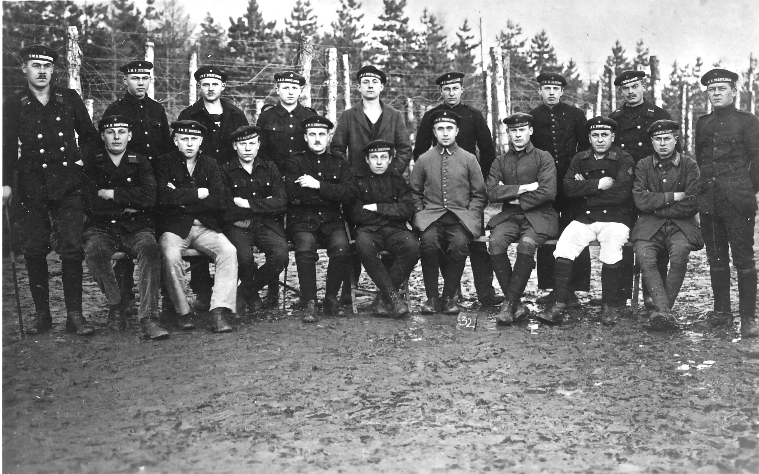
FROM THE FLOW TO P.O.W.
Notes:
Käse’s Tours of Berlin
Football
3 Day strike

Slide 17
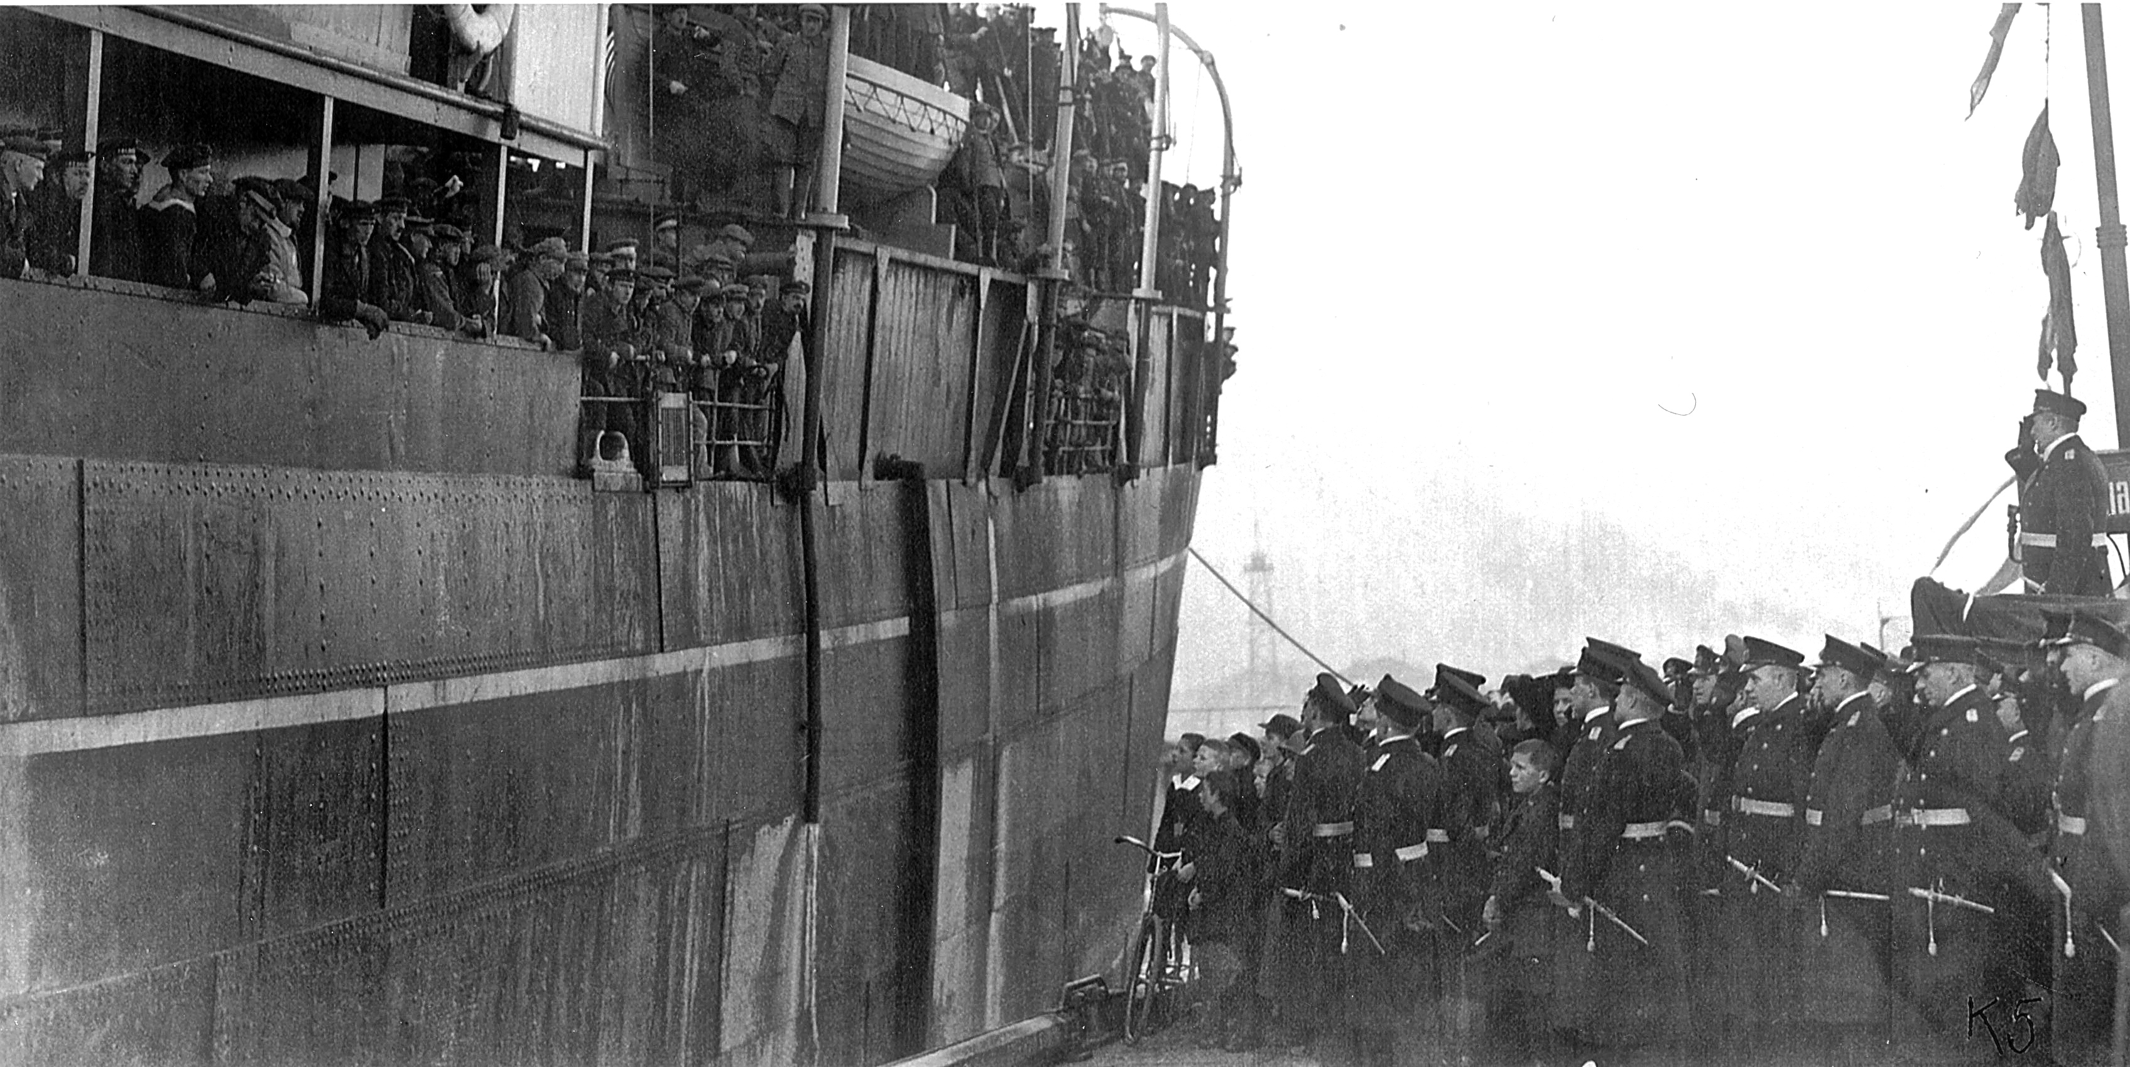
REPATRIATION
31 January, 1919
Notes:
- Von Trotha waiting

Slide 18
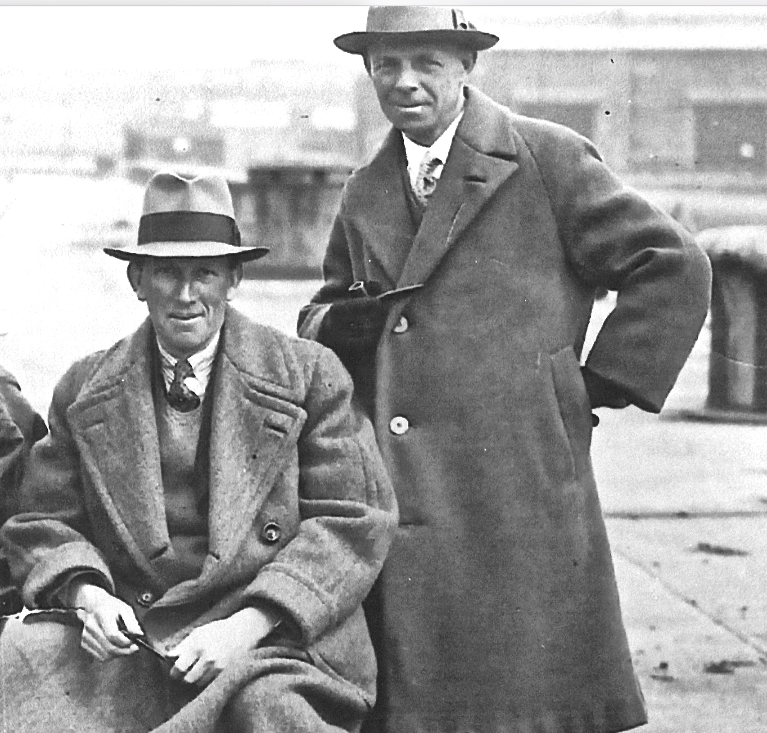
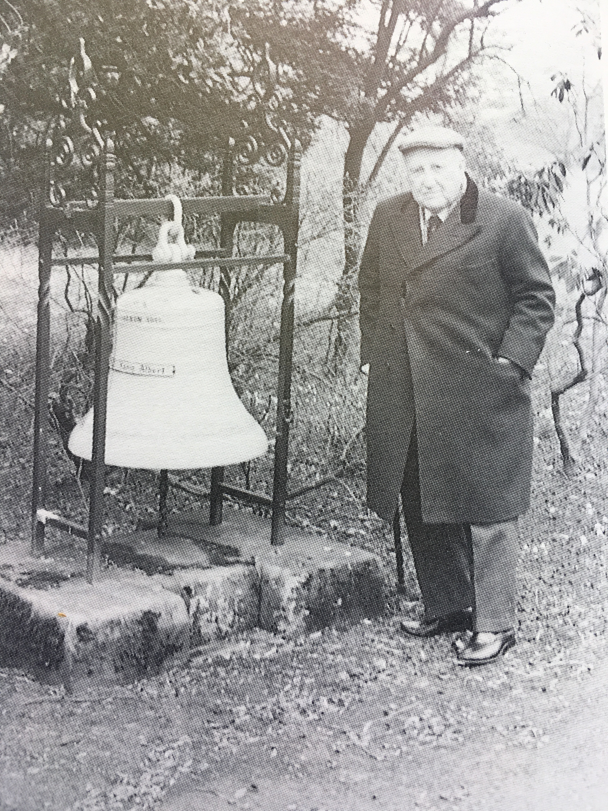
THE GREATEST SALVAGE IN HISTORY
Low Admiralty expectations
Ernest Cox, Cox and Danks
Robert McCrone, Metal Industries
Tom McKenzie
Ernest Cox and Bob McKenzie
Robert McCrone
Notes:
We have Bob McCrone younest daughter her today, Helena Young. She remembers Tom McKenzie

Slide 19
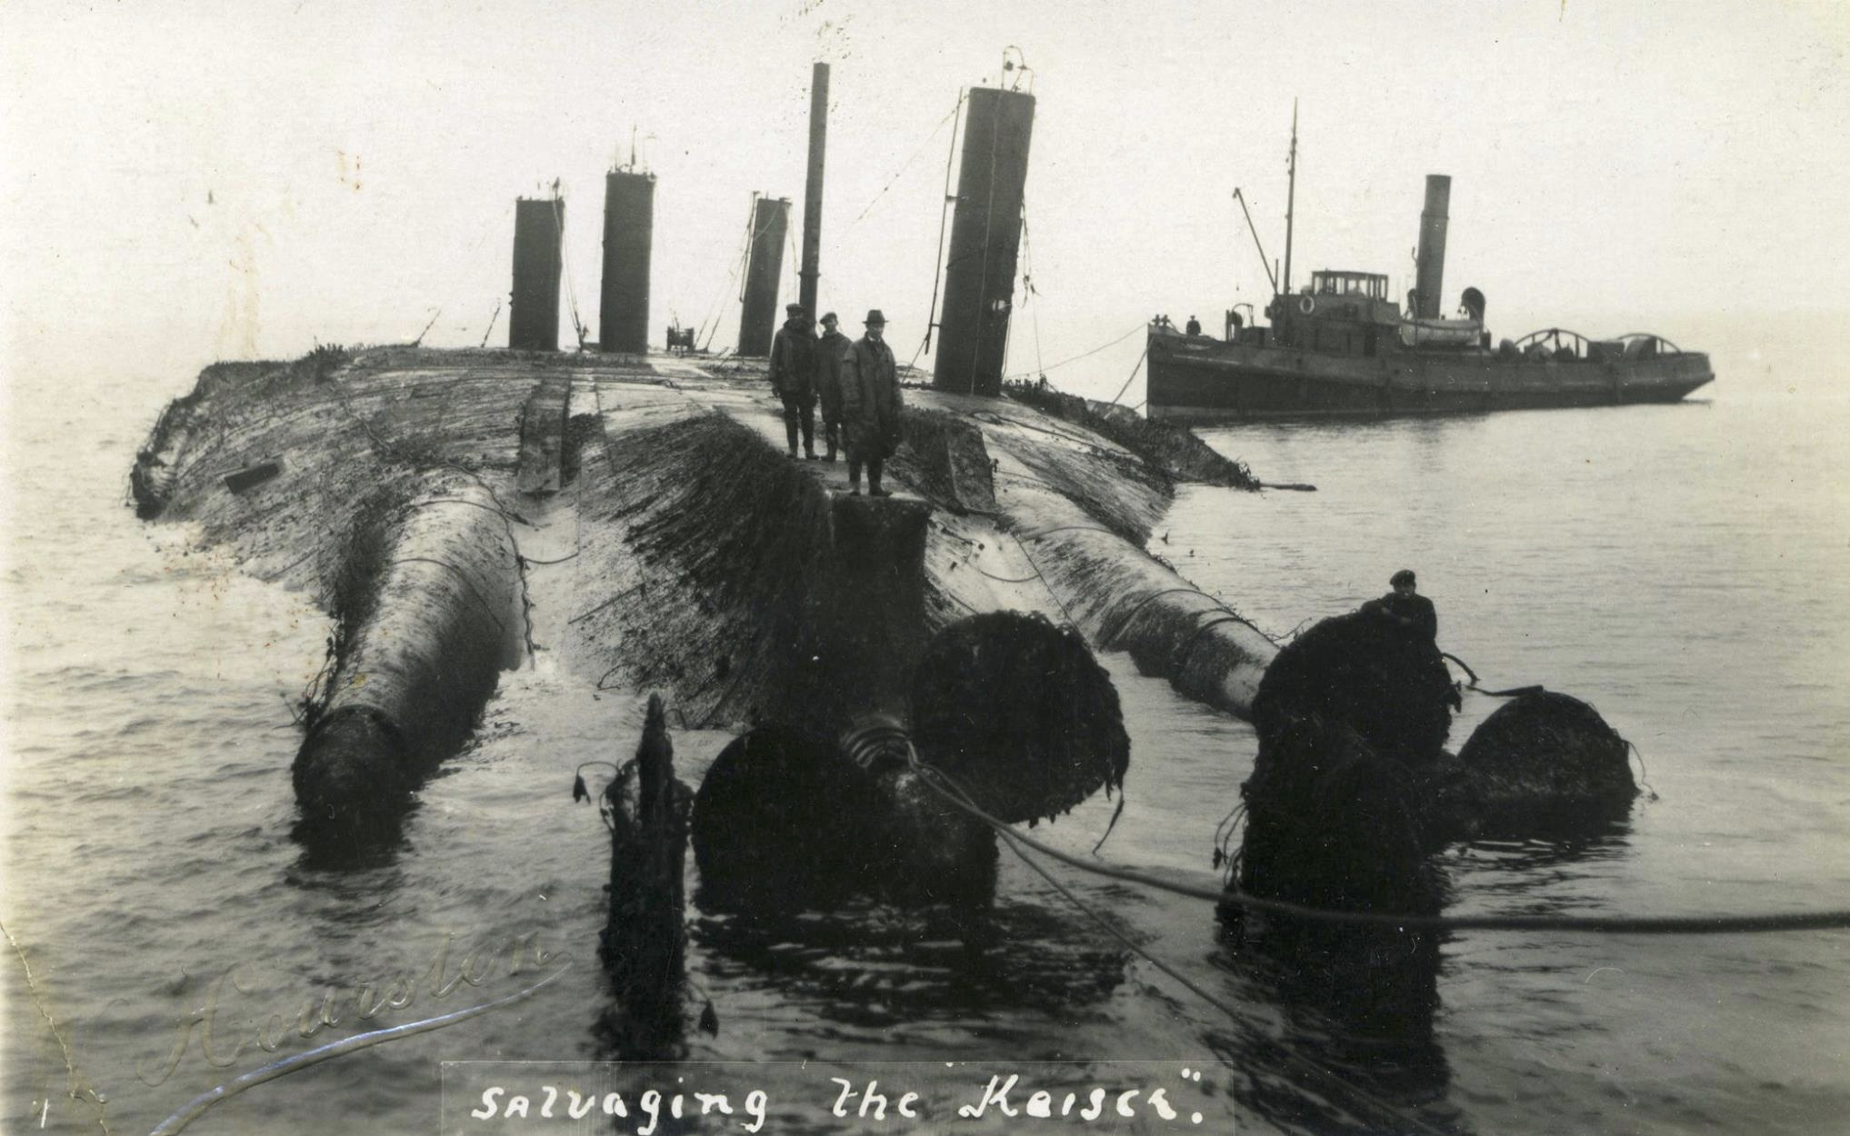
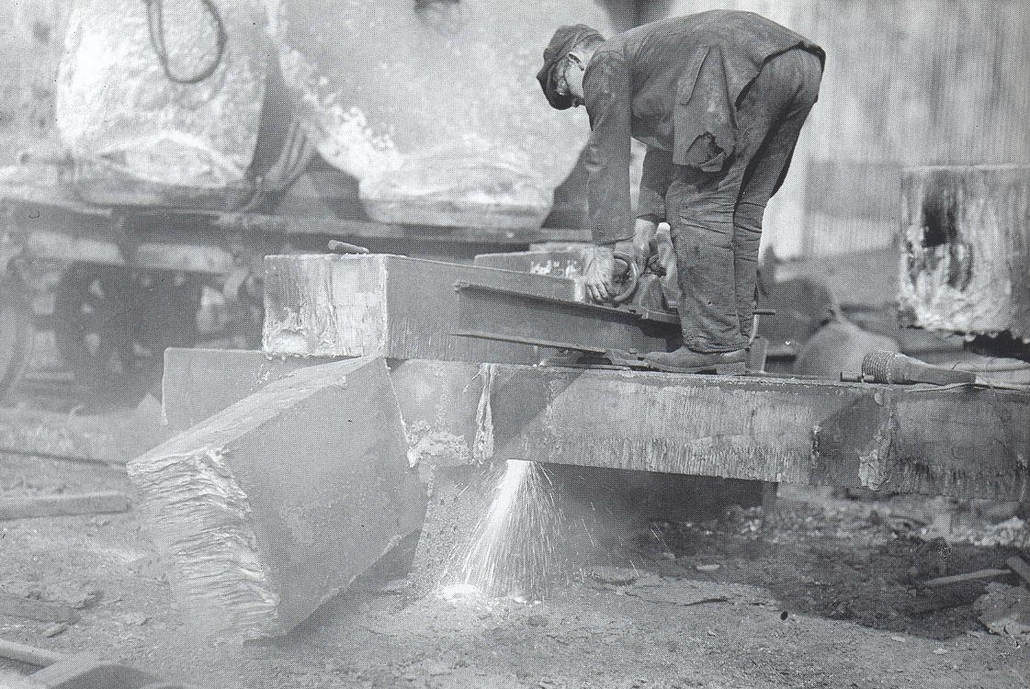
THE GREATEST SALVAGE IN HISTORY

Slide 20
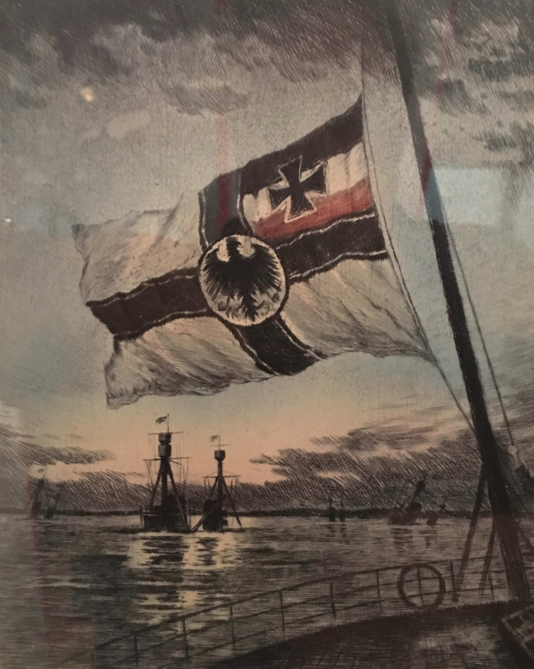
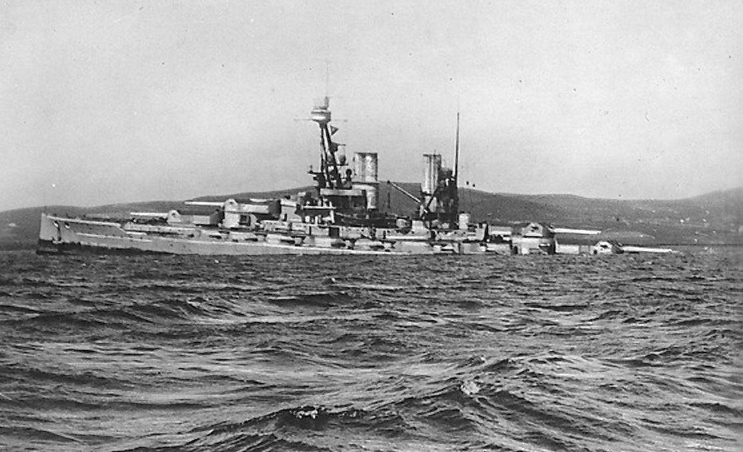
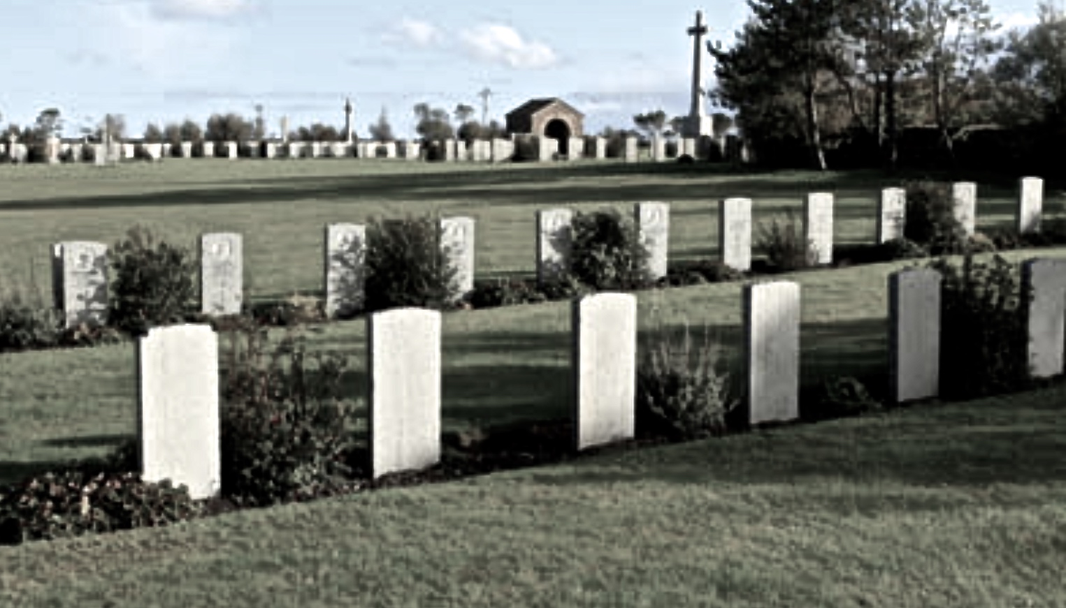
WAS IT WORTH IT?

